Slide 1
Programming Language Trends
Philip Dumaresq | Systems IV

Slide 2
Why do we have so many programming languages?

Slide 3
Agenda
A brief history of high level programming languages
Top programming languages today and the ones that will be focused on
Analyzing some of the characteristics of these languages
Outliers among these languages – Python and Ruby
Biases against some of them – PHP and JavaScript
Learning Computer Science or Coding
My recommendation to the college

Slide 4
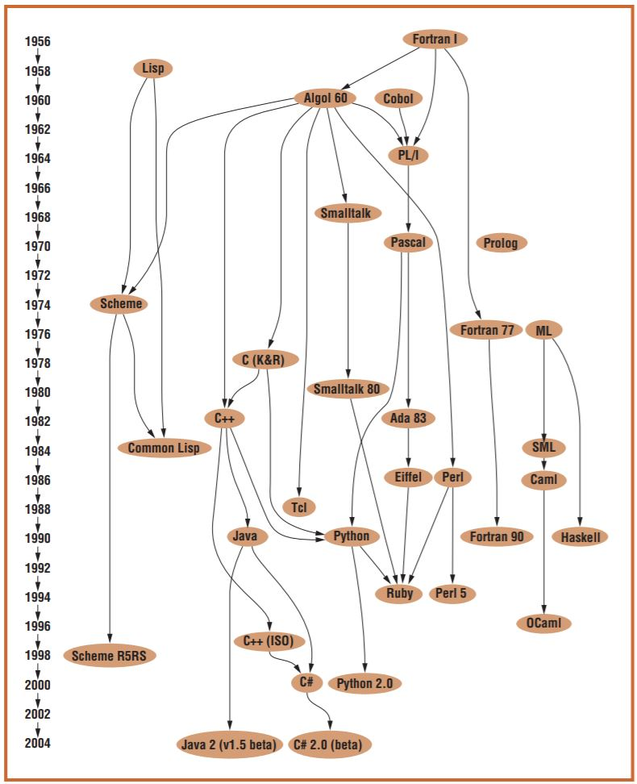
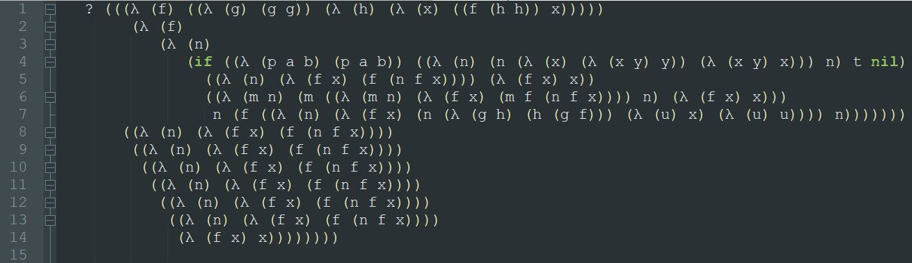
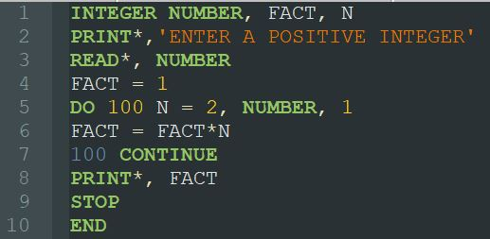
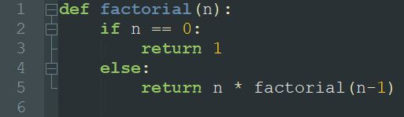
Brief History of Programming Languages

Slide 5
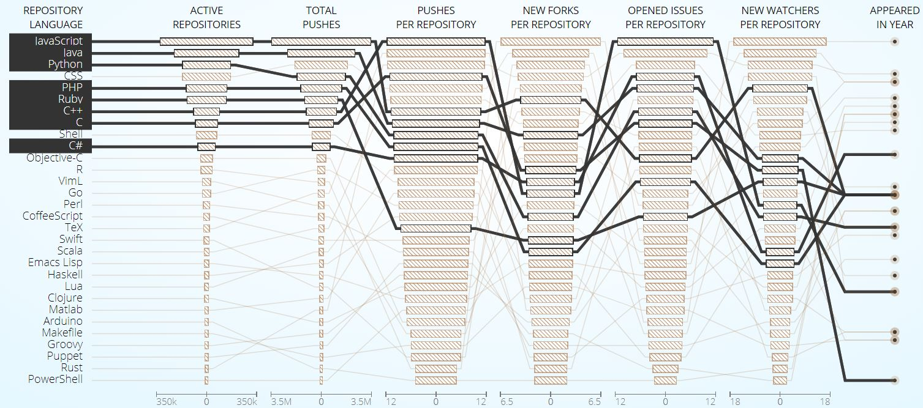
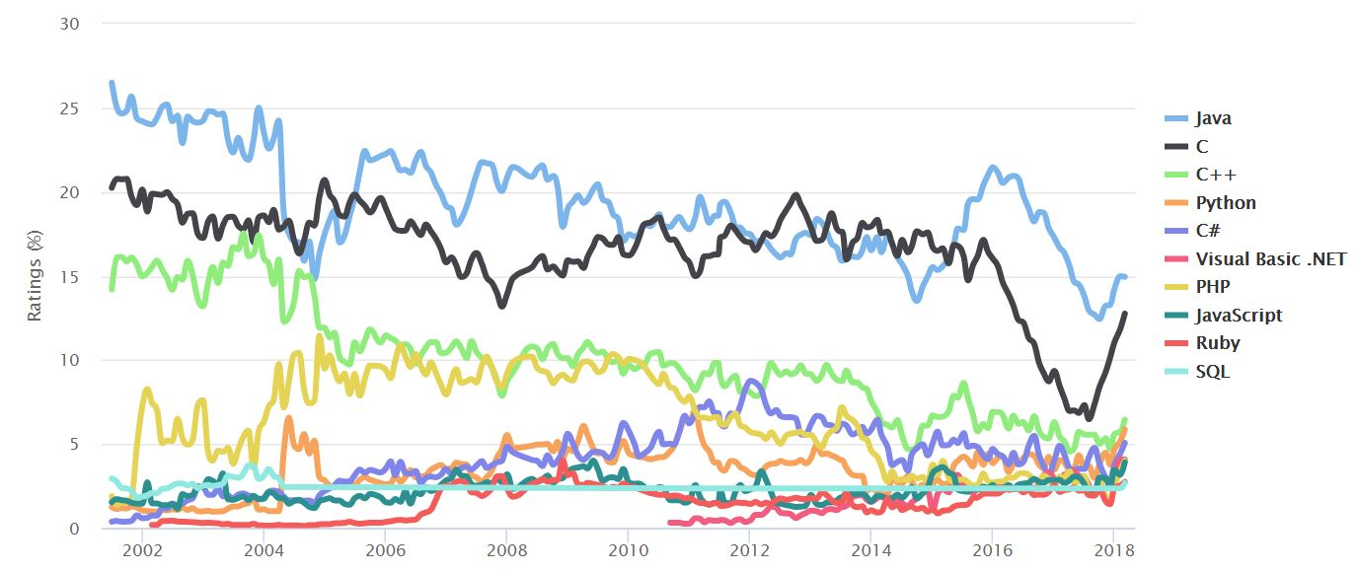
Top Programming Languages Used Today

Slide 6
Drawing Some Parallels
To try to find out what makes these languages so popular, we’re going to look at different properties of the languages including:
Their speed
Their syntaxes
The paradigms that they fall under
Their community support and industry support
What they’ve inspired.

Slide 7
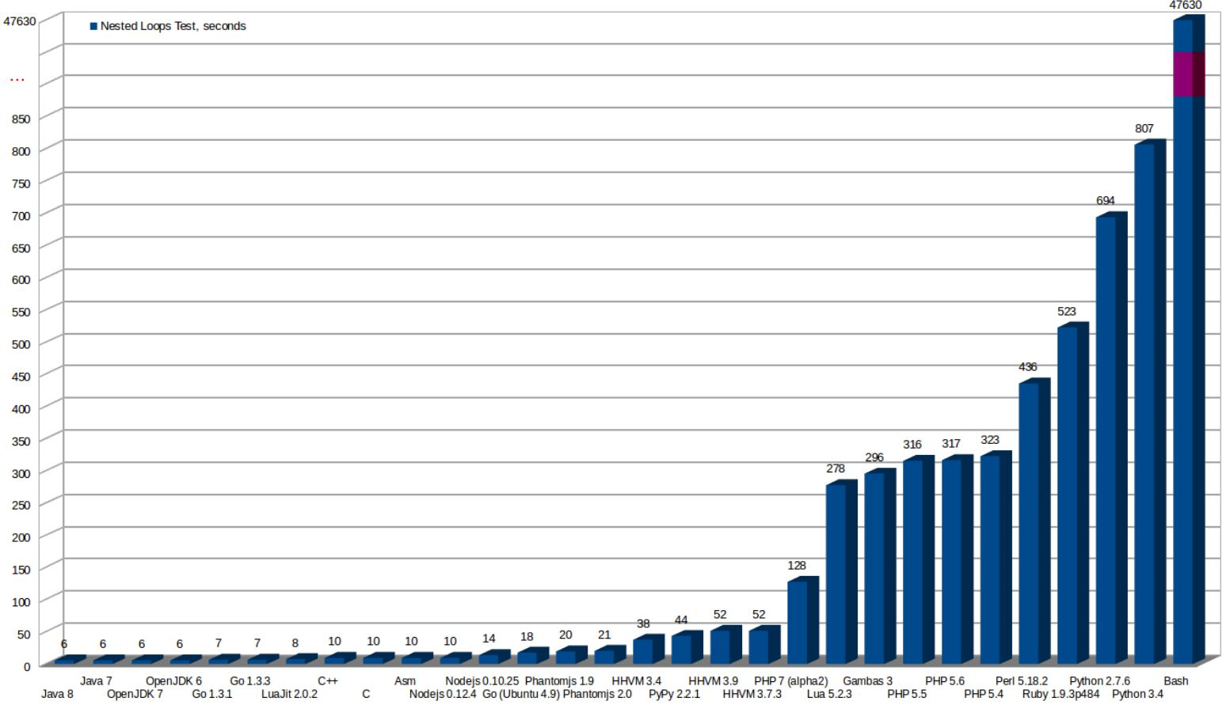
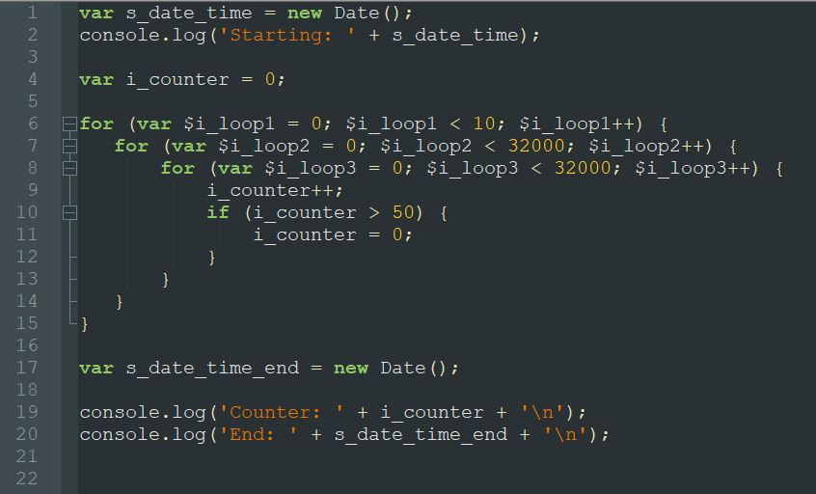
Speed Benchmarking

Slide 8
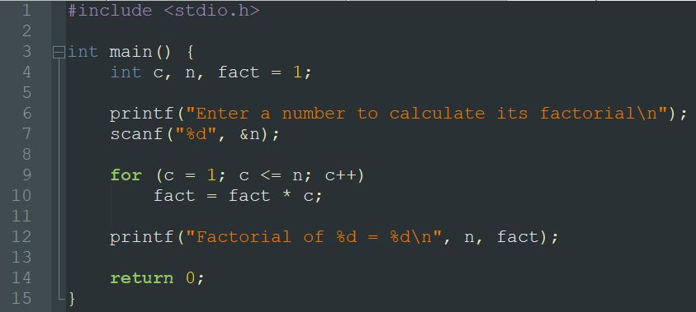
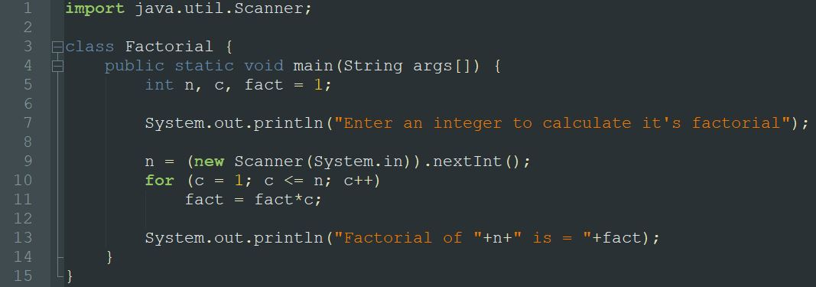
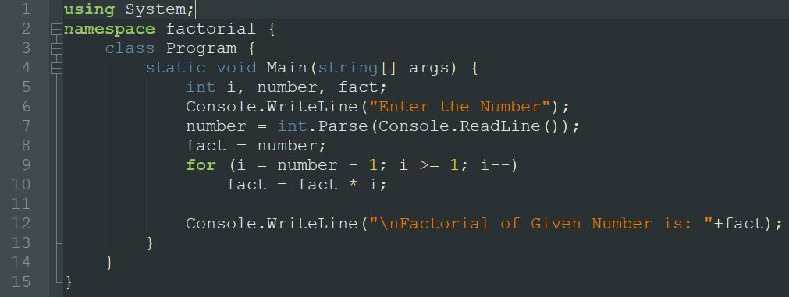
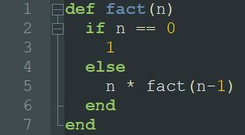
Syntax

Slide 9
Programming Paradigms
Object-Oriented Programming
C++
Java
Python
Ruby
PHP
JavaScript
C#
Functional Programming
Python
Ruby
PHP
JavaScript
Support basic functional features like lambdas (NOT inferring that they are functional)
Java
C#

Slide 10
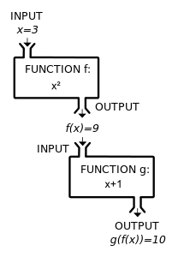
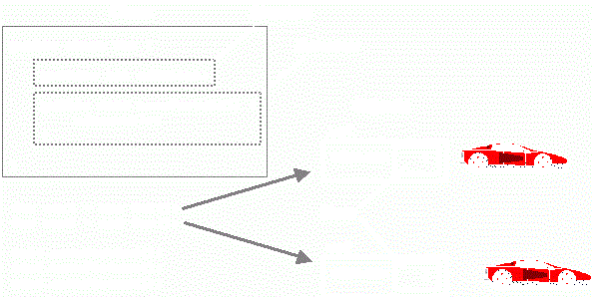
Programming Paradigms

Slide 11
Community and Industry Support
C – ISO
C++ – ISO
C# – Microsoft
Java – Oracle
PHP – Zend Technologies
JavaScript – Ecma International, Mozilla, Google
Python – Python Software Foundation
Ruby – Open source

Slide 12
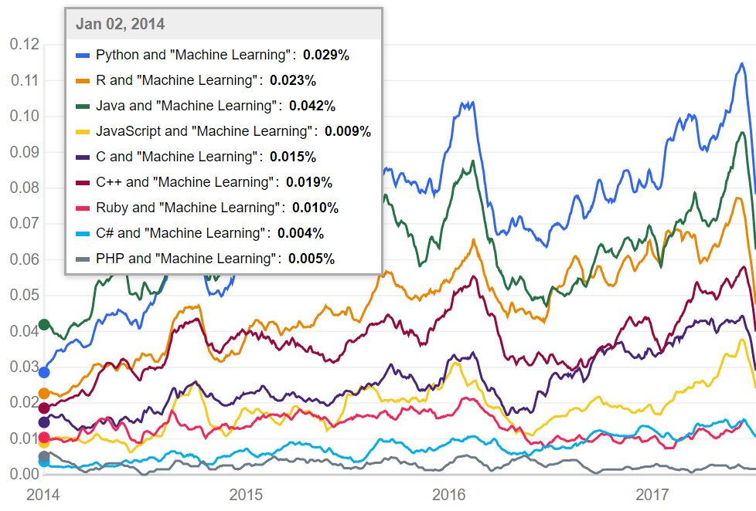
Outliers in the Group

Slide 13
Biases among Developers

Slide 14
Starting in Computer Science and Coding

Slide 15
One Universal Language

Slide 16
Suggestion to The College

